Slide 1

Parallel Programming in C with MPI and OpenMP
Michael J. Quinn

Slide 2
Chapter 7
Performance Analysis

Slide 3
Learning Objectives
Predict performance of parallel programs
Understand barriers to higher performance

Slide 4
Outline
General speedup formula
Amdahl’s Law
Gustafson-Barsis’ Law
Karp-Flatt metric
Isoefficiency metric

Slide 5
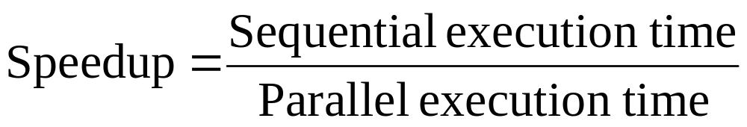
Speedup Formula

Slide 6
Execution Time Components
Inherently sequential computations: σ(n)
Potentially parallel computations: ϕ(n)
Communication operations: κ(n, p)

Slide 7
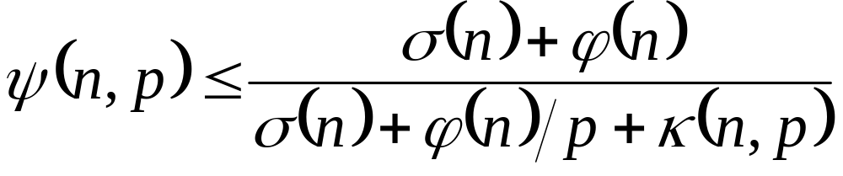
Speedup Expression
ψ(n, p): speedup achieved solving a problem of size n on p processors.

Slide 8
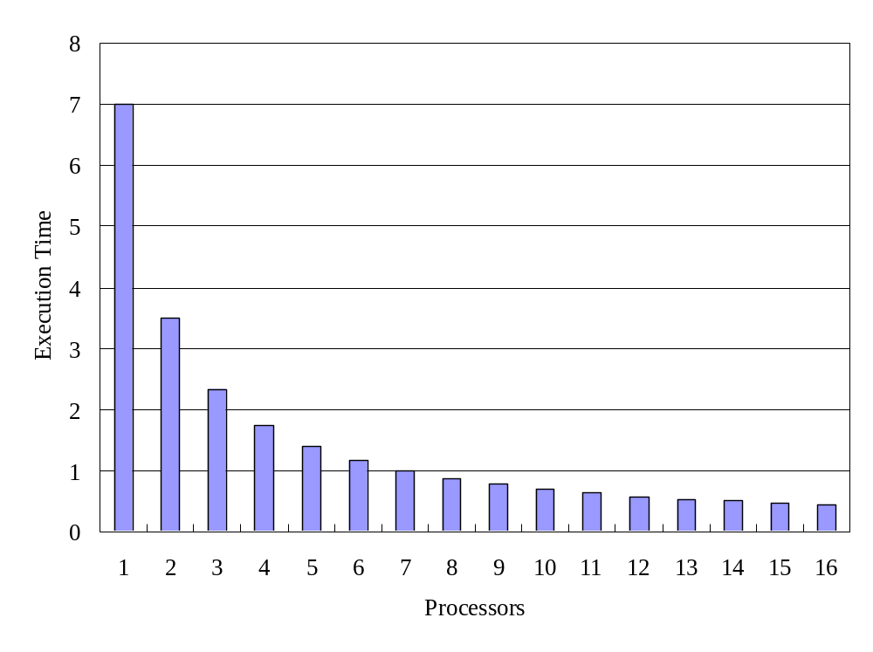
Parallel Component: ϕ(n)/p

Slide 9
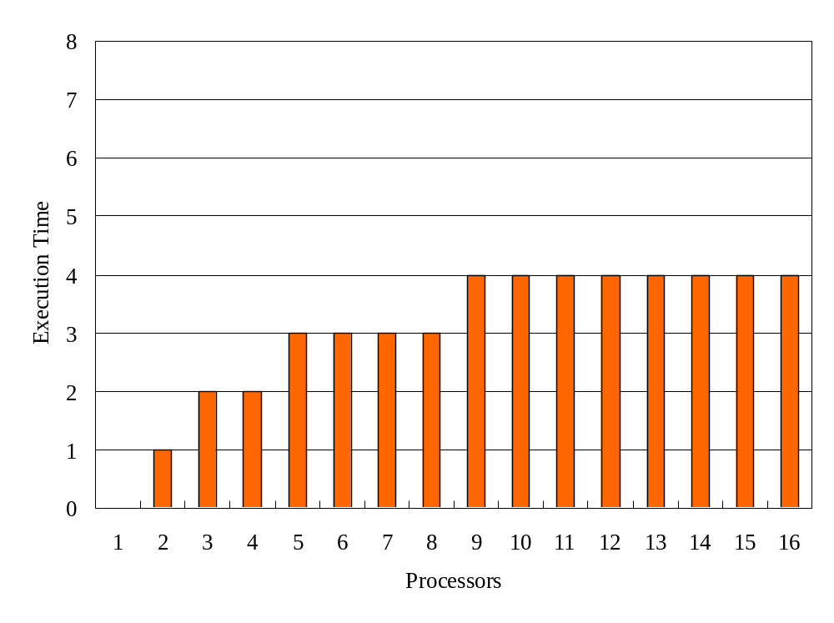
Communication Component: κ(n, p)

Slide 10
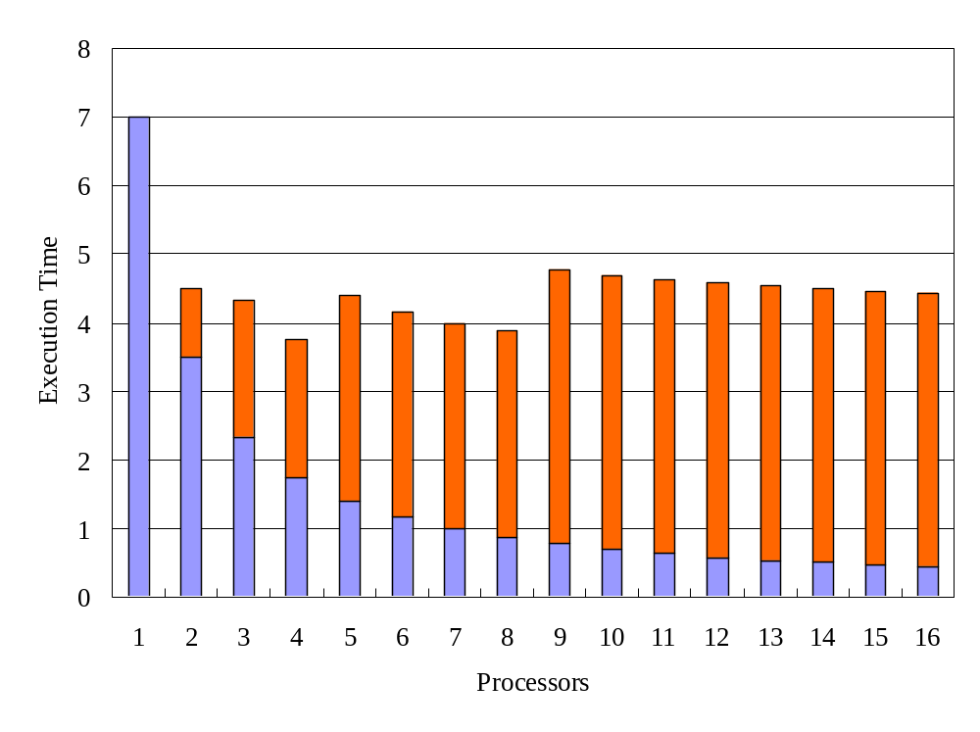
ϕ(n)/p + κ(n, p)

Slide 11
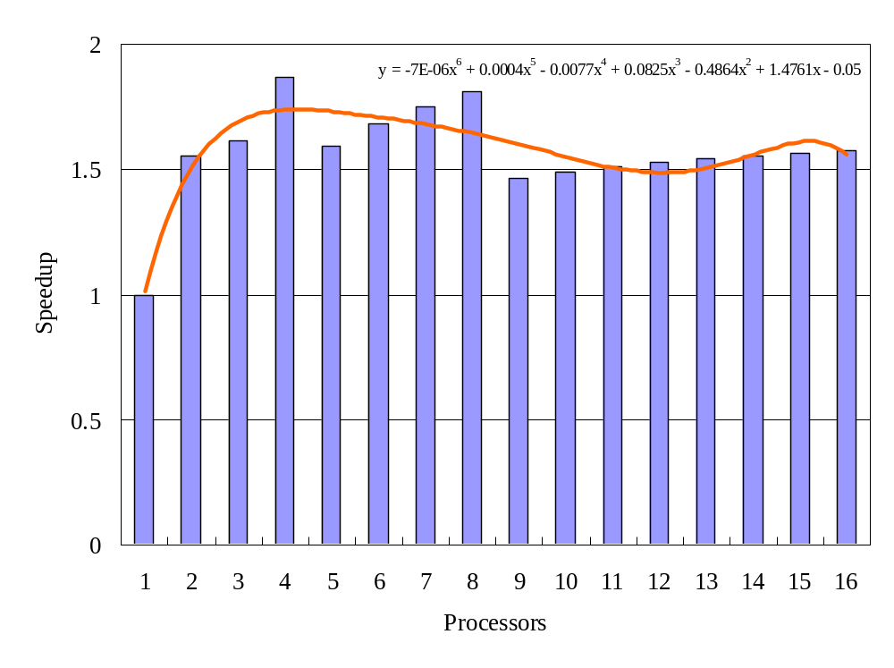
Speedup Plot
“elbowing out”

Slide 12
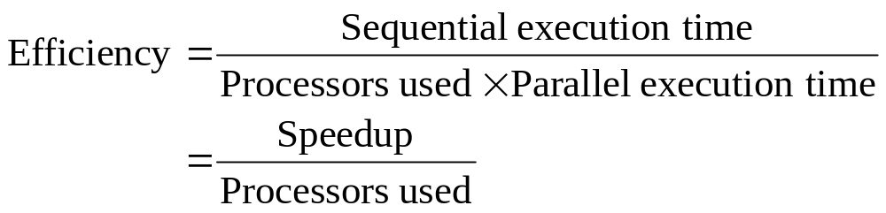
Efficiency

Slide 13
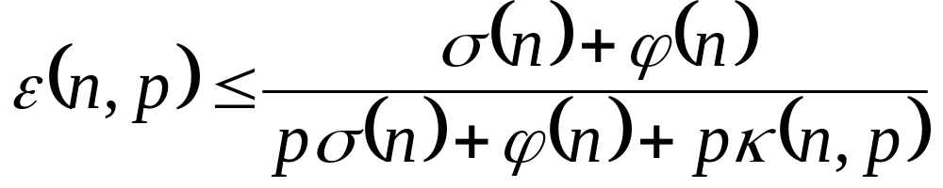
0 ≤ ε(n,p) ≤ 1
All terms > 0 ⇒ ε(n, p) > 0
Denominator > numerator ⇒ ε(n, p) < 1

Slide 14
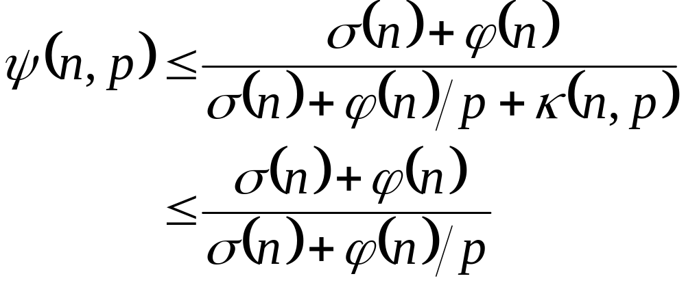
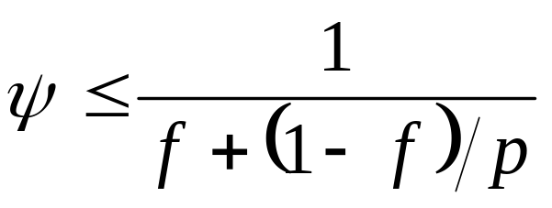
Amdahl’s Law
Let f = σ (n)/(σ (n) + ϕ (n))

Slide 15
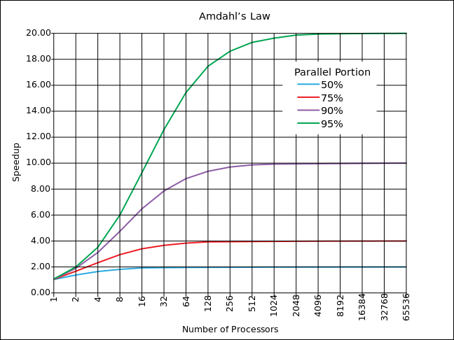

Slide 16
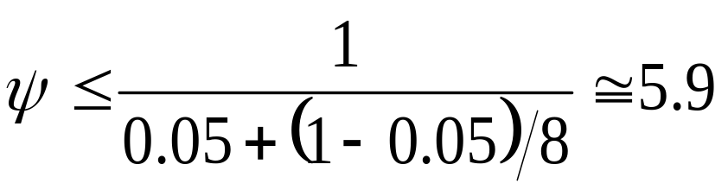
Example 1
95% of a program’s execution time occurs inside a loop that can be executed in parallel. What is the maximum speedup we should expect from a parallel version of the program executing on 8 CPUs?

Slide 17
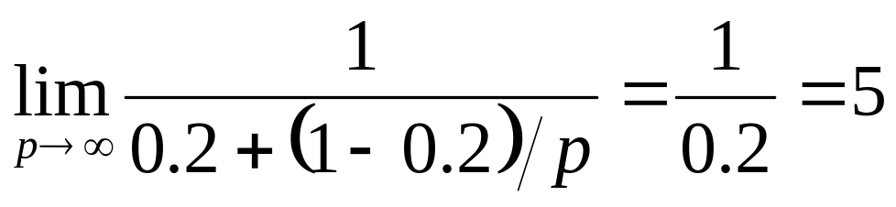
Example 2
20% of a program’s execution time is spent within inherently sequential code. What is the limit to the speedup achievable by a parallel version of the program?

Slide 18
Pop Quiz
An oceanographer gives you a serial program and asks you how much faster it might run on 8 processors. You can only find one function amenable to a parallel solution.
Benchmarking on a single processor reveals 80% of the execution time is spent inside this function. What is the best speedup a parallel version is likely to achieve on 8 processors?

Slide 19
Pop Quiz
A computer animation program generates a feature movie frame-by-frame. Each frame can be generated independently and is output to its own file. If it takes 99 seconds to render a frame and 1 second to output it, how much speedup can be achieved by rendering the movie on 100 processors?

Slide 20
Limitations of Amdahl’s Law
Ignores κ(n, p)
Overestimates speedup achievable

Slide 21
Amdahl Effect
Typically κ(n, p) has lower complexity than ϕ(n)/p
As n increases, ϕ(n)/p dominates κ(n,p)
As n increases, speedup increases

Slide 22
Illustration of Amdahl Effect
Speedup
n = 10,000
n = 1,000
n = 100
Processors

Slide 23
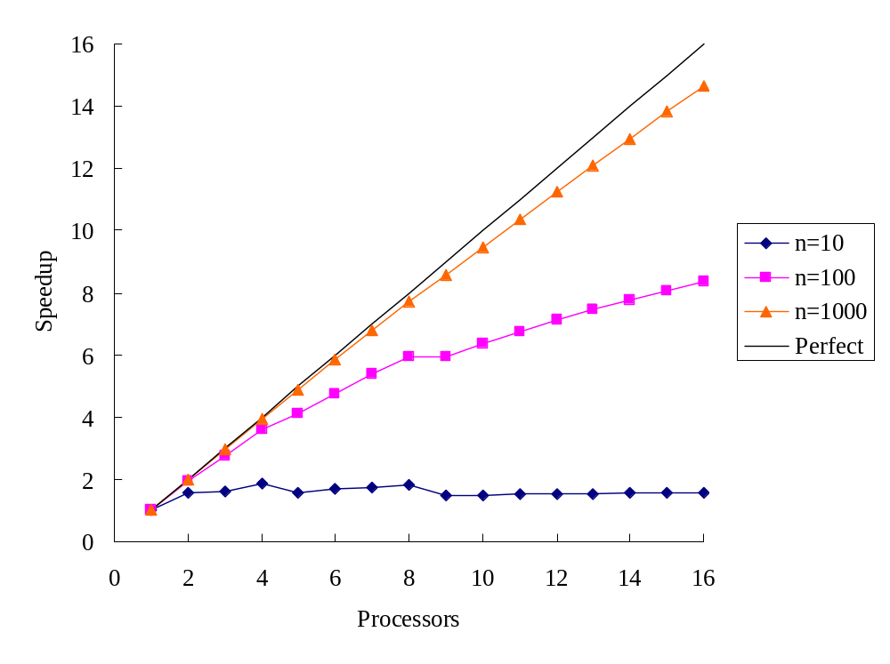
Illustration of Amdahl Effect

Slide 24
Review of Amdahl’s Law
Treats problem size as a constant
Shows how execution time decreases as number of processors increases

Slide 25
Another Perspective
We often use faster computers to solve larger problem instances
Let’s treat time as a constant and allow problem size to increase with number of processors

Slide 26
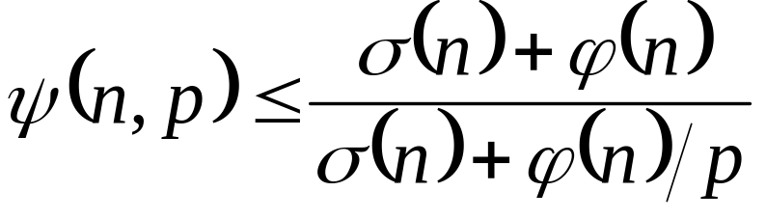
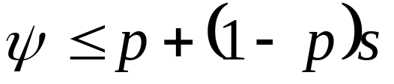
Gustafson-Barsis’s Law
Let s = σ(n)/(σ(n)+ϕ(n)/p)

Slide 27
Gustafson-Barsis’s Law
Begin with parallel execution time
Estimate sequential execution time to solve same problem
Problem size is an increasing function of p
Predicts scaled speedup

Slide 28
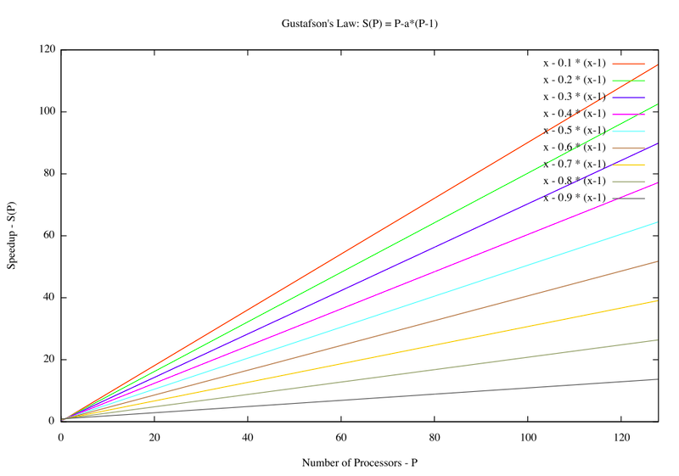

Slide 29
Example 1
An application running on 10 processors spends 3% of its time in serial code. What is the scaled speedup of the application?
…except 9 do not have to execute serial code
Execution on 1 CPU takes 10 times as long…

Slide 30
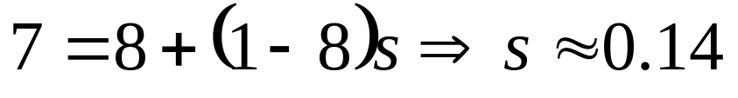
Example 2
What is the maximum fraction of a program’s parallel execution time that can be spent in serial code if it is to achieve a scaled speedup of 7 on 8 processors?

Slide 31
Pop Quiz
A parallel program executing on 32 processors spends 5% of its time in sequential code. What is the scaled speedup of this program?

Slide 32
The Karp-Flatt Metric
Amdahl’s Law and Gustafson-Barsis’ Law ignore κ(n, p)
They can overestimate speedup or scaled speedup
Karp and Flatt proposed another metric

Slide 33
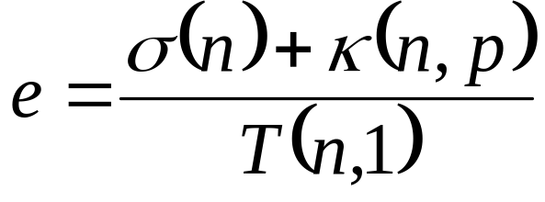
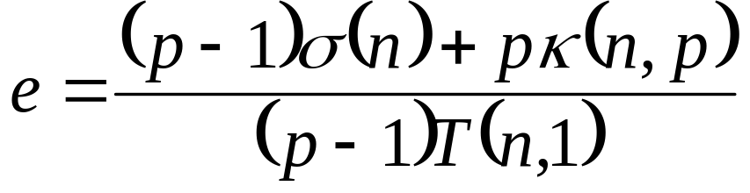
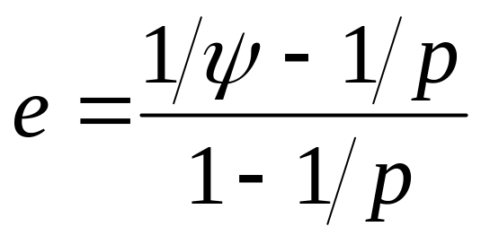
Experimentally Determined Serial Fraction
Inherently serial component of parallel computation + processor communication and synchronization overhead
Single processor execution time

Slide 34
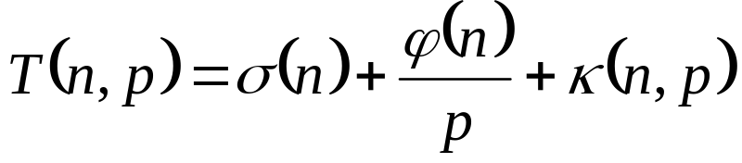

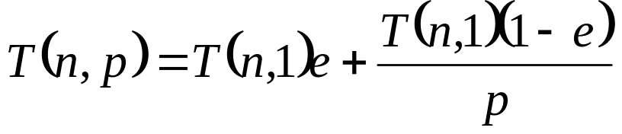
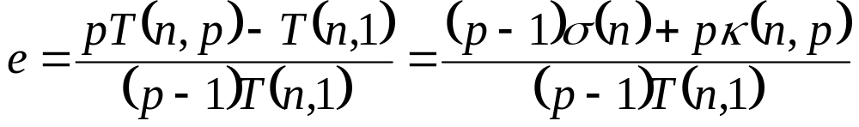
Derive the Definition of e

Slide 35
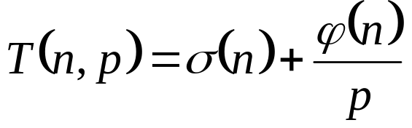
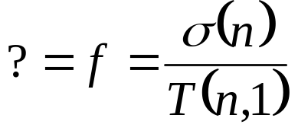
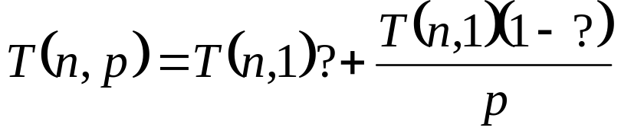
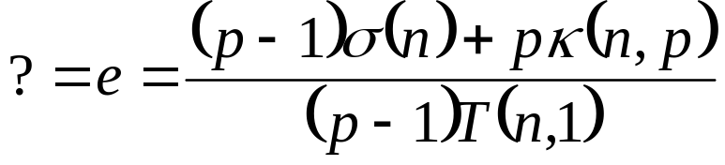
Compare e with f
Simple model
Complex model

Slide 36
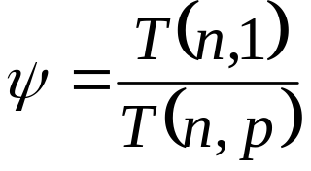
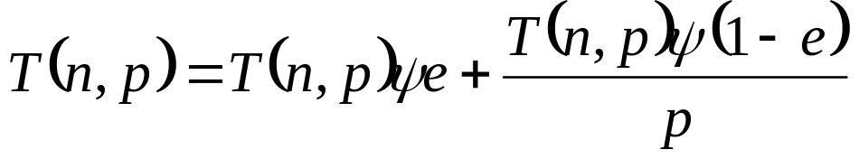
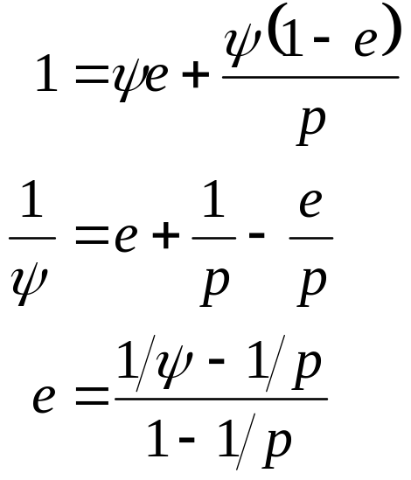
Derive the Karp-Flatt Metric

Slide 37
Experimentally Determined Serial Fraction
Takes into account parallel overhead
Detects other sources of overhead or inefficiency ignored in speedup model
  Process startup time
  Process synchronization time
  Imbalanced workload
  Architectural overhead

Slide 38
Example 1
What is the primary reason for speedup of only 4.7 on 8 CPUs?
Since e is constant, large serial fraction is the primary reason.
p | 2 | 3 | 4 | 5 | 6 | 7 | 8
ψ | 1.8 | 2.5 | 3.1 | 3.6 | 4.0 | 4.4 | 4.7
e | 0.1 | 0.1 | 0.1 | 0.1 | 0.1 | 0.1 | 0.1

Slide 39
Example 2
What is the primary reason for speedup of only 4.7 on 8 CPUs?
Since e is steadily increasing, overhead is the primary reason.
p | 2 | 3 | 4 | 5 | 6 | 7 | 8
ψ | 1.9 | 2.6 | 3.2 | 3.7 | 4.1 | 4.5 | 4.7
e | 0.070 | 0.075 | 0.080 | 0.085 | 0.090 | 0.095 | 0.100

Slide 40
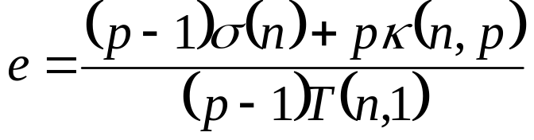
Pop Quiz
Is this program likely to achieve a speedup of 10 on 12 processors?
p | 4 | 8 | 12
ψ | 3.9 | 6.5 | ?
↑
p | 4 | 8 | 12
ψ | 3.9 | 6.5 | 10
e | 0.008547 | 0.032967 | 0.018182
e decreasing is impossible.

Slide 41
Isoefficiency Metric
Parallel system: parallel program executing on a parallel computer
Scalability of a parallel system: measure of its ability to increase performance as number of processors increases
A scalable system maintains efficiency as processors are added
Isoefficiency: way to measure scalability

Slide 42
Isoefficiency Derivation Steps
Begin with speedup formula
Compute total amount of overhead
Assume efficiency remains constant
Determine relation between sequential execution time and overhead

Slide 43
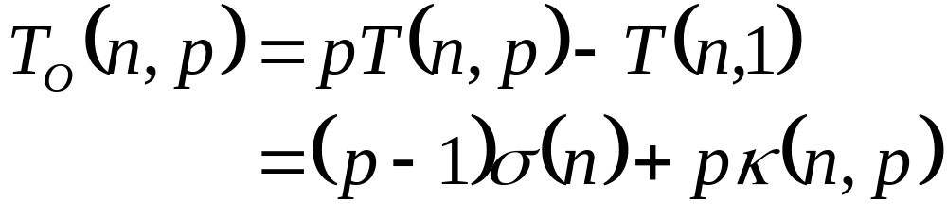
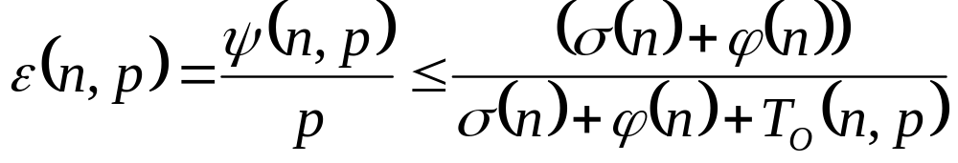
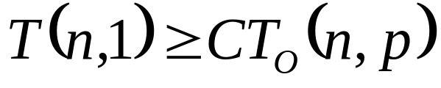
Deriving Isoefficiency Relation
Determine overhead
Substitute overhead into speedup equation
Substitute T(n,1) = σ(n) + ϕ(n). Assume efficiency is constant.
Isoefficiency Relation

Slide 44
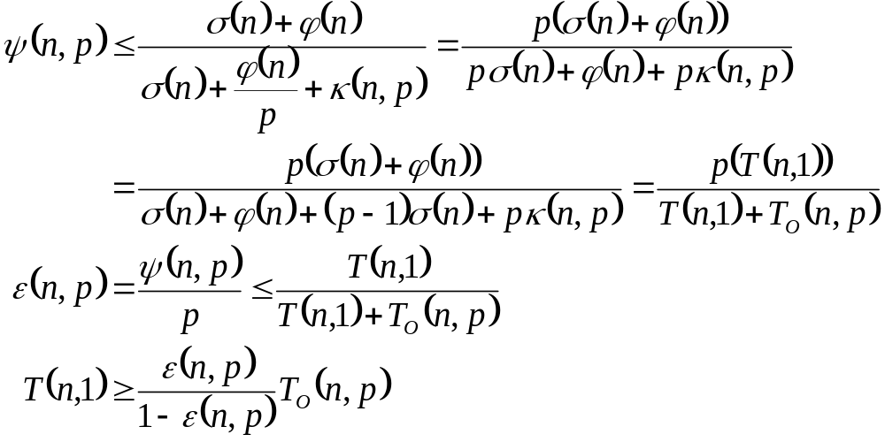
Deriving Isoefficiency Relation (2)

Slide 45
Scalability Function
Suppose the final isoefficiency relation is
n ≥ f(p)
Let M(n) denote memory required for problem of size n
M(f(p))/p shows how memory usage per processor must increase to maintain same efficiency
We call M(f(p))/p the scalability function

Slide 46
Meaning of Scalability Function
To maintain efficiency when increasing p, we must increase n
Maximum problem size limited by available memory, which is linear in p
Scalability function shows how memory usage per processor must grow to maintain efficiency
Scalability function a constant means parallel system is perfectly scalable

Slide 47
Interpreting Scalability Function
Cp log p
Cannot maintain
efficiency
Cp
Memory needed per processor
Memory Size
Can maintain
efficiency
C log p
C
Number of processors

Slide 48
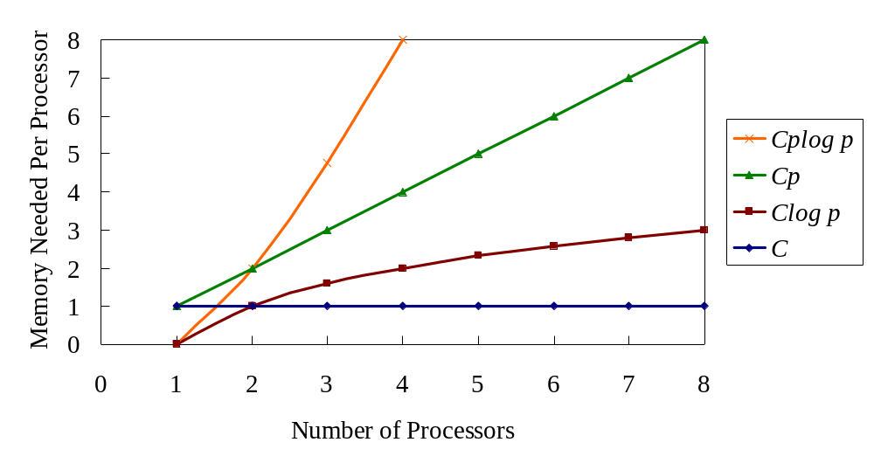
Interpreting Scalability Function

Slide 49
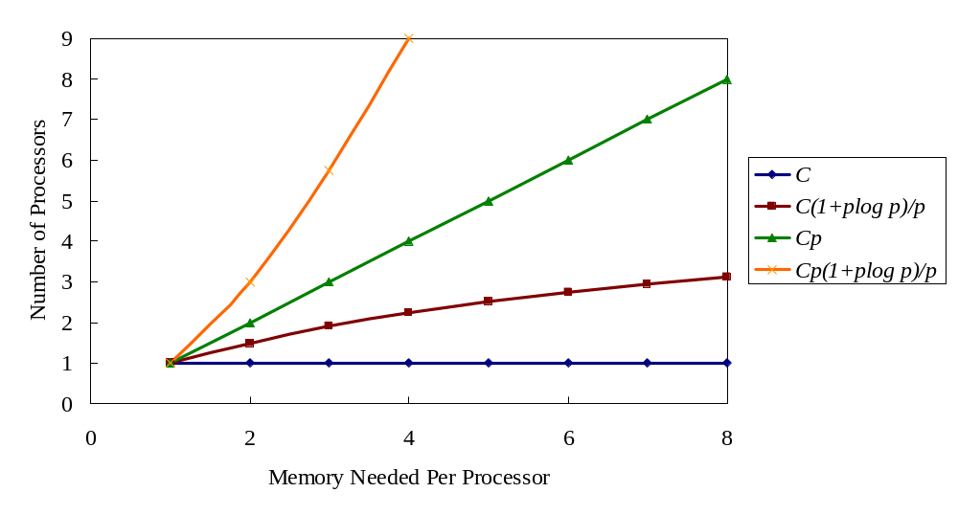
Interpreting Scalability Function

Slide 50
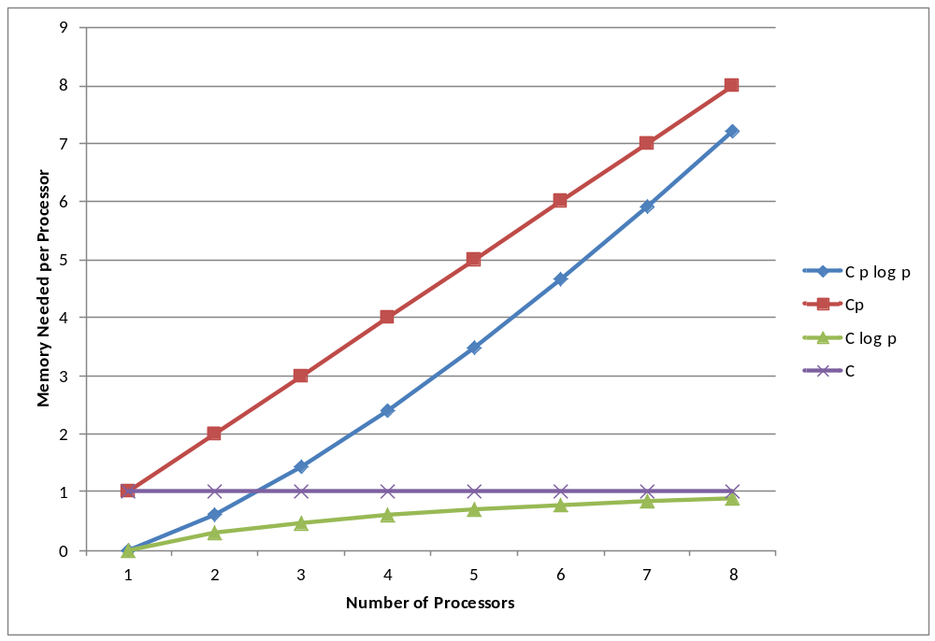

Slide 51
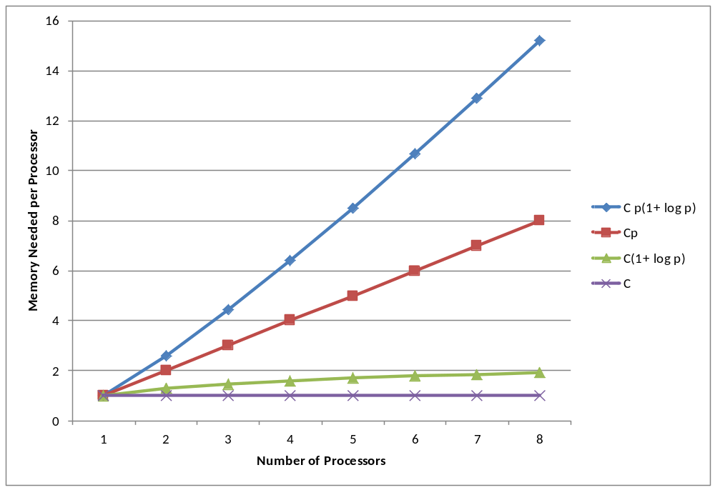

Slide 52
Example 1: Reduction
Sequential algorithm complexity
T(n, 1) = Θ(n)
Parallel algorithm
  Computational complexity = Θ(n/p)
  Communication complexity = Θ(log p)
Parallel overhead
T_{O}(n, p) = Θ(p log p)

Slide 53
Reduction (continued)
Isoefficiency relation: n ≥ Cp log p
We ask: To maintain same level of efficiency, how must n increase when p increases?
M(n) = n
The system has good scalability

Slide 54
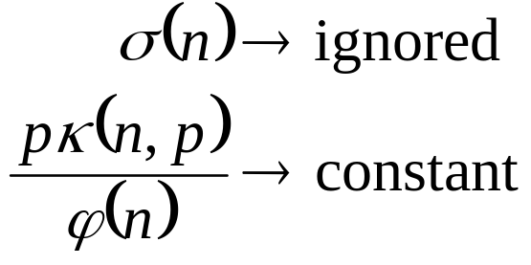
Reduction
Maintain isoefficiency
T(n, p)
φ
κ

Slide 55
Example 2: Floyd’s Algorithm
Sequential time complexity: Θ(n³)
Parallel computation time: Θ(n³/p)
Parallel communication time: Θ(n²log p)
Parallel overhead: T_{O}(n, p) = Θ(pn²log p)

Slide 56
Floyd’s Algorithm (continued)
Isoefficiency relation
n³ ≥ C(p n² log p) ⇒ n ≥ C p log p
M(n) = n²
The parallel system has poor scalability

Slide 57
Example 3: Finite Difference
Sequential time complexity per iteration: Θ(n²)
Parallel communication complexity per iteration: Θ(n/√p)
Parallel overhead: Θ(n √p)

Slide 58
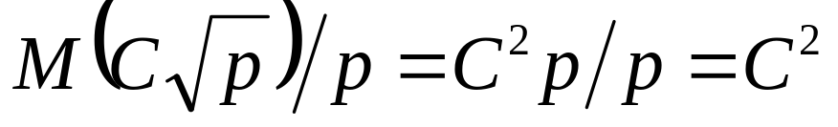
Finite Difference (continued)
Isoefficiency relation
n² ≥ Cn√p ⇒ n ≥ C√p
M(n) = n²
This algorithm is perfectly scalable

Slide 59
Summary (1/3)
Performance terms
  Speedup
  Efficiency
Model of speedup
  Serial component
  Parallel component
  Communication component

Slide 60
Summary (2/3)
What prevents linear speedup?
  Serial operations
  Communication operations
  Process start-up
  Imbalanced workloads
  Architectural limitations

Slide 61
Summary (3/3)
Analyzing parallel performance
  Amdahl’s Law
  Gustafson-Barsis’ Law
  Karp-Flatt metric
  Isoefficiency metric

Slide 62
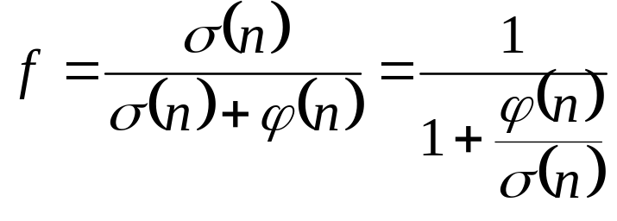

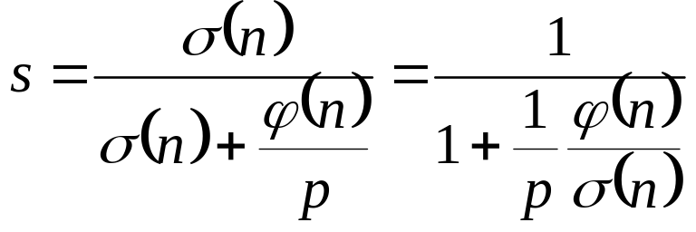
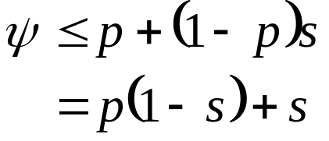
Exercise 7.11

Slide 63
Exercises
5.9
6.12
7.10

